Slide 1
Instructions for presenting on these slides
Thank you for your interest in the EHR Proxy (Shared) Access Project for Family Care Partners, funded by The John A. Hartford Foundation.
This slide deck is a template for clinicians and staff who want to disseminate the pilot resources with your clinical and marketing teams.
You are encouraged to modify this presentation template for your own uses.
Audiences you should share this presentation with include:
Clinical staff
Patient-facing staff
Marketing/Communications staff
Patient portal team (e.g., MyChart)
Patient/family advisory councils (PFACs)

Slide 2
Why is shared access to the patient portal important?
The U.S. health care delivery system does not systematically engage or support care partners (caregivers).
Technology innovations like shared (proxy) access are a crucial strategy that allows patients to identify who they do and do not want to involve in their care.
The uptake of shared access is limited, and when care partners access portals they most often use the patient's identity credentials.
As digital modalities increase the patients’ role in health care interactions, so does the importance of making shared access work for all stakeholders involved (i.e., patients, clinicians, and care partners).
Related research: https://coalitionforcarepartners.org/#Past-Research

Slide 3
What is shared access?
Shared access is sometimes referred to as proxy access.
Shared access provides care partners with legitimacy and information transparency when engaging in health system activities about a patient's health and their treatments.
Shared access can help clinicians better understand who is involved in health system interactions when it is someone other than a patient.
When used as designed, shared access facilitates a bi-directional information exchange between patients, clinicians, and care partners.
Getting shared access to work well for patients, care partners, and clinicians is critically important as digital modalities become the mainstream mode of interaction in health care.
Note: Shared access is different from a medical proxy—which is a person legally authorized to make decisions upon the behalf of a person who is physically or mentally unable to make their own medical decisions.

Slide 4
Who else is piloting the shared access materials featured in this presentation?
10,000+ physicians
50+ hospitals
Church-operated
Minor teaching hospital
Piloted in primary care, 3 clinics, 2 city, 34 clinicians
93 staff
Urban setting
30,000 patients*
EHR: Epic since 2011
1,200 physicians
2 hospitals
Non-profit
Major teaching hospital
Piloted in geriatrics & geriatric psychiatry, 19 clinicians
20 staff
Urban setting
17,000+ patients*
EHR: Epic since 2010
1,500 physicians
6 hospitals
Non-profit
Major teaching hospital
Piloted in geriatrics oncology, 1 clinic, 8 clinicians
5 staff
Urban setting
500+ patients*
EHR: Epic since 2012
*Patient characteristics at all sites: age 65+, # for total visits annually

Slide 5
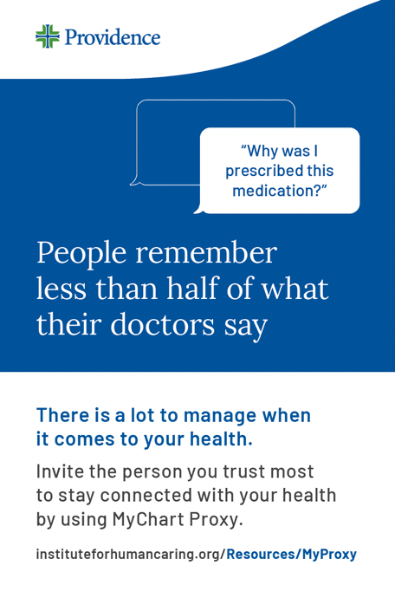
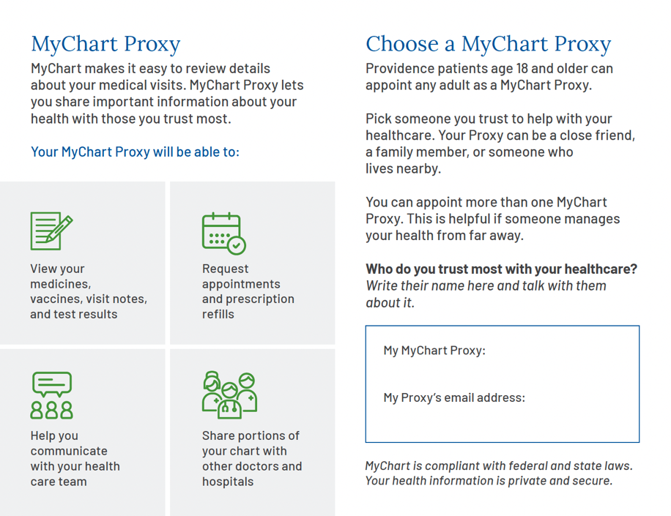
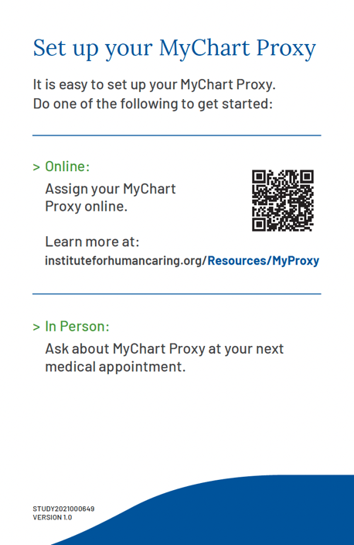
Providence handout (English)
5.5”x8.5”
Exam Room Booklet
2-sided, folded
FRONT
INSIDE
BACK

Slide 6
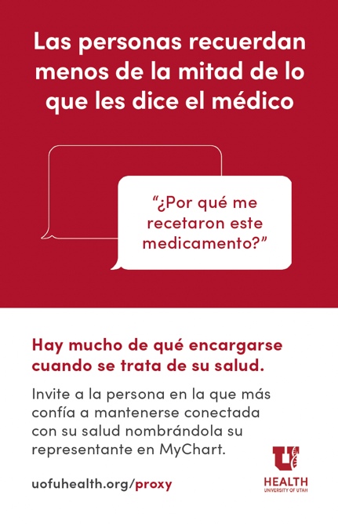
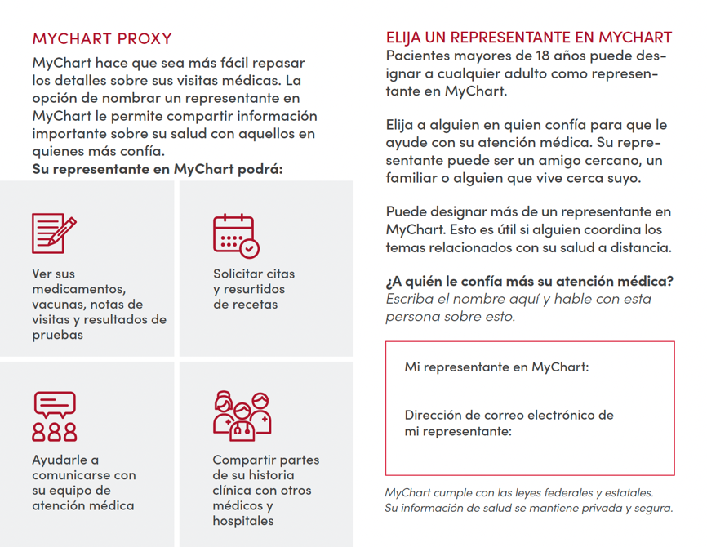
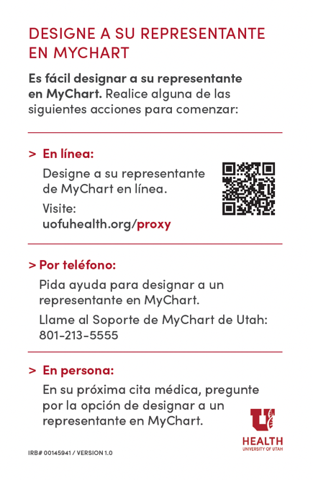
Utah handout (Spanish)
5.5”x8.5”
Exam Room Booklet
2-sided, folded
FRONT
INSIDE
BACK

Slide 7
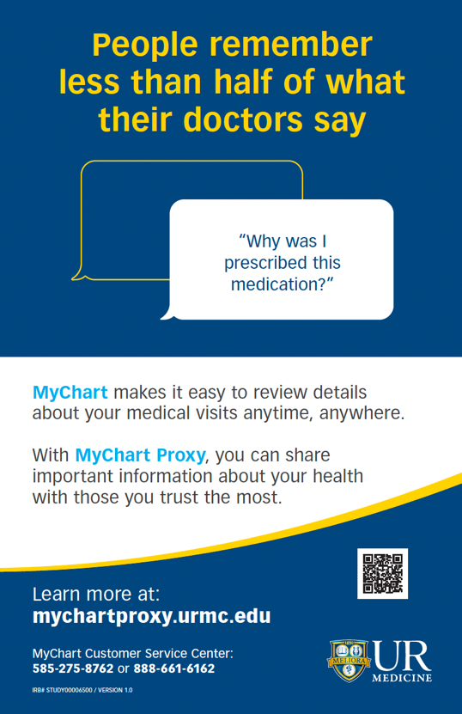
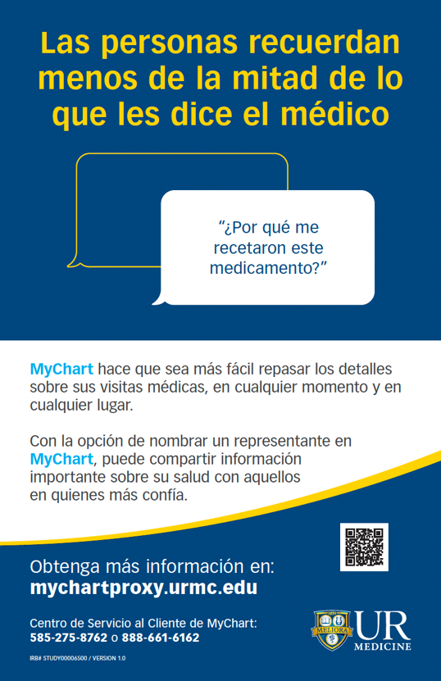
UR Medicine poster (English & Spanish)
11” x 17”
Exam Room Poster
laminated
⚠️
Exam room posters must be laminated to adhere to The Joint Commission Guidelines for safety

Slide 8
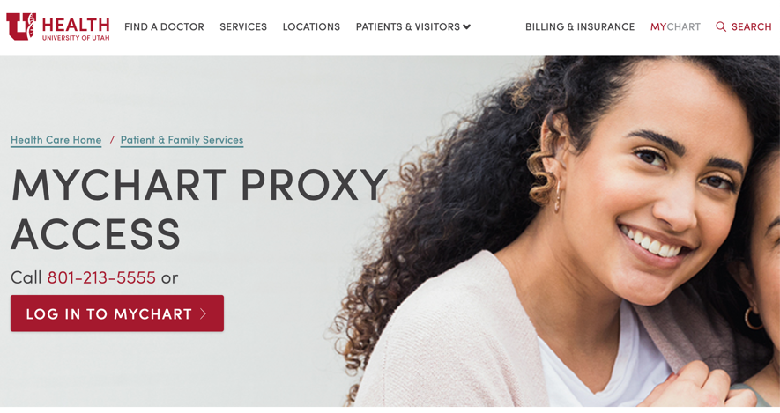
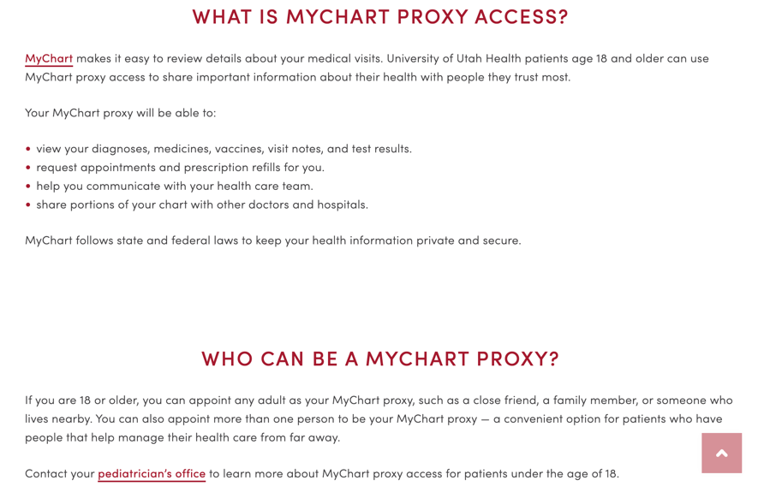
Website text
Text should be edited and modified to match your organization’s branding and portal details
Example:
University of Utah Health

Slide 9
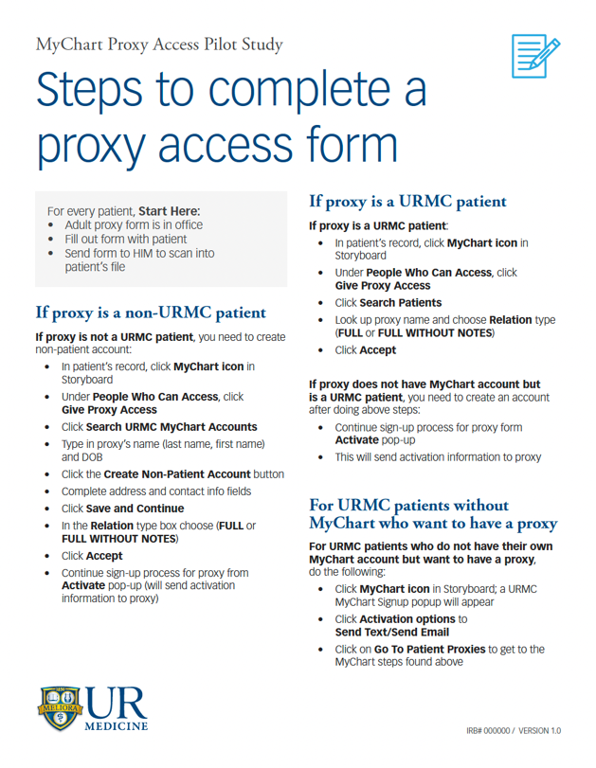
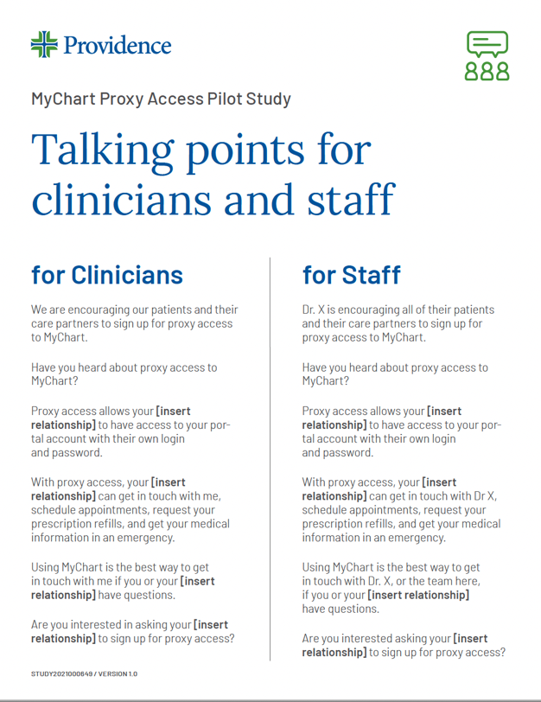
8.5”x11”
Staff Tip Sheet
1-sided
8.5”x11”
Staff Talking Points
1-sided
Talking points & Tip sheets

Slide 10
Marketing & Communications
Health systems implementing this pilot are highly encouraged to partner with your existing marketing and communications staff to have your materials printed professionally for your dissemination efforts.
Templates are available for:
Adobe Indesign (.indd) (handouts and posters)
Word (.doc) (for custom text modifications)
Note: Each health system should create unique instructions for your patient portal users. Work closely with your patient portal team to design your instructions and test it on your website.

Slide 11
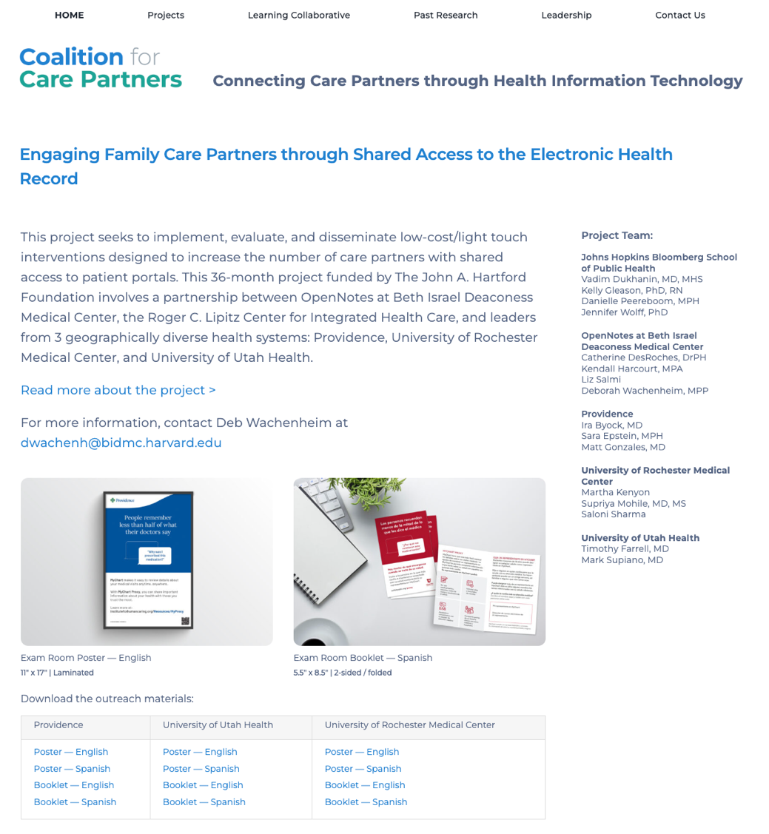
Download examples and templates
https://coalitionforcarepartners.org/engaging-family-care-partners/
Notes:
https://coalitionforcarepartners.org/engaging-family-care-partners/

